Slide 1
React Component Lifecycle
Anju Munoth

Slide 2
Component Lifecycles
Component lifecycle consists of methods that are invoked in series when a component is mounted or updated.
These methods are invoked either before or after the component renders the UI.
render method itself is a part of the component lifecycle.
Each React component comes with several methods that allows developers to update the application state and reflect the change to UI.
Three main phases of a component - mounting, updating and unmounting.

Slide 3
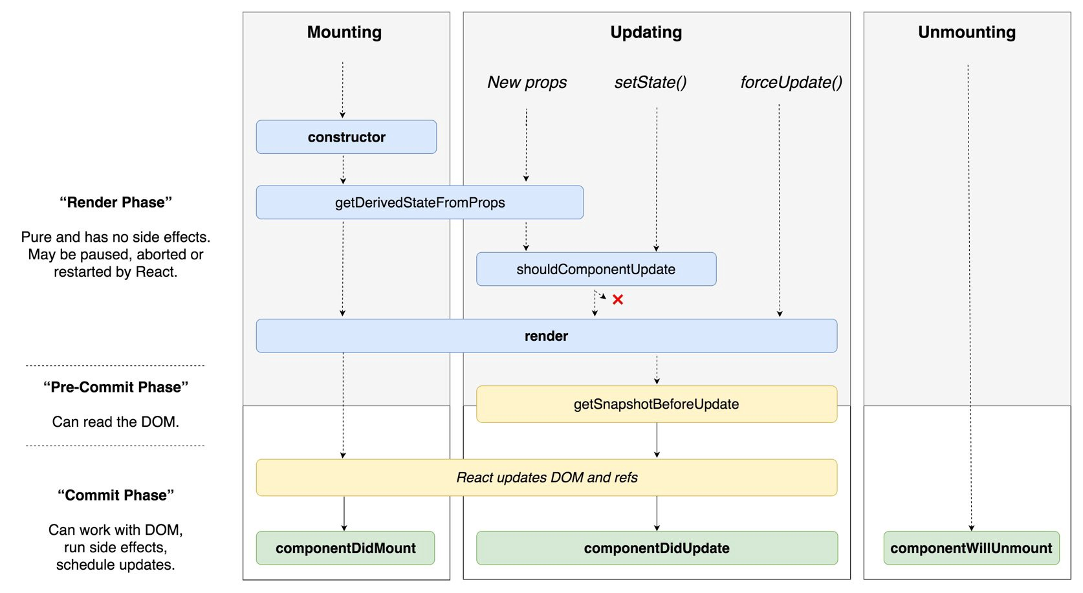

Slide 4
Mounting Lifecycle
Consists of methods that are invoked when a component is mounted or unmounted.
Used to initially set up state, make API calls, start and stop timers, manipulate the rendered DOM, initialize third-party libraries, and more.
Used to incorporate JavaScript to assist in the initialization and destruction of a component.
These methods will be called when an instance of a React component is created and mounted into the DOM.
constructor()

Slide 5
component mounting lifecycle
ES6 class | React.createClass()
 | getDefaultProps()
constructor(props) | getInitialState()
componentWillMount() | componentWillMount()
render() | render()
componentDidMount() | componentDidMount()
componentWillUnmount() | componentWillUnmount()

Slide 6
constructor()
This method get called before a React component is mounted.
Very essential to call super(props) before any statement in the constructor.
This is because it will allow us to call the constructor of the parent class and initialize itself in case our class extends any other class which has constructor itself.
Otherwise, this.props will be undefined
constructor is perfect for initializing state or bind the event handlers to the class instance

Slide 7
componentWillMount
Invoked before the DOM is rendered
Can be used to initialize third-party libraries, start animations, request data, or perform any additional setup that may be required before a component is rendered.
Possible to invoke setState from this method to change the component state just before the component is initially rendered.
Will be called once before the component is mounted and it will run before the render function.
Can be used to fetch data from other endpoint in order to retrieve the data for the initial render by many developers
However, there is no guarantee that the request will be finished before the render function is called.

Slide 8
componentWillMount - Example
componentWillMount() {
this.setState({loading: true})
getFakeMembers(this.props.count).then(
members => {this.setState({members, loading: false}) },
error => { this.setState({error, loading: false}) }
)}

Slide 9
Using setState in componentWillMount
Calling setState before the component has rendered will not kick off the updating lifecycle.
Calling setState after the component has been rendered will kick off the updating lifecycle.
If you call setState inside an asynchronous callback defined within the componentWillMount method, it will be invoked after the component has rendered and will trigger the updating lifecycle

Slide 10
componentWillMount
This function has been deprecated in 16.X
Will be changed to UNSAFE_componentWillMount from version 17.

Slide 11
static getDerivedStateFromProps(nextProps, prevState)
Invoked when the component is mounted as well as receives new props whether they are changed or not.
It is also called if the parent component re-renders, so if you want to only update change of value, it is vital to have the previous and new value comparison.
This function should return an object to update state or null because the static function will not have any acknowledge to this.
If your component has state that is initialized from the props receiving from the parents. This function is right place to sync up your props and state.

Slide 12
Example
static getDerivedStateFromProps(nextProps, prevState) {
if (nextProps.value !== prevState.value) {
console.log('props changed. Return an object to change state');
return {
value: nextProps.value,
}
}

Slide 13
static getDerivedStateFromProps(nextProps, nextState)
In summary, this function will be called when:
The component is initialized.
Receiving new props whether they are changed or not.
Parent component is re-rendered.
Note: when this function is implemented, it is likely that the componentWill* functions will not be invoked.

Slide 14
componentDidMount
componentDidMount is invoked just after the component has rendered
componentDidMount is a good place to make API requests.
Is invoked after the component has rendered, so any setState calls from this method will kick off the updating lifecycle and rerender the component.
Also a good place to initialize any third-party JavaScript that requires a DOM.
For instance, may want to incorporate a drag-and-drop library or a library that handles touch events.
Typically, these libraries require a DOM before they can be initialized.
Another good use for componentDidMount is to start background processes like intervals or timers.
Any processes started in componentDidMount or componentWillMount can be cleaned up in componentWillUnmount.
Don’t want to leave background processes running when they are not needed.

Slide 15
componentWillUnmount
componentWillUnmount is invoked just before the component is unmounted.
Components are unmounted when their parents remove them or they have been unmounted with the unmountComponentAtNode function found in react-dom.
This method is used to unmount the root component.
When a root component is unmounted, its children are unmounted first.

Slide 16
import React from 'react'
import { render, unmountComponentAtNode } from 'react-dom'
import { getClockTime } from './lib'
const target = document.getElementById('react-container')
class Clock extends React.Component {
constructor() {
super()
this.state = getClockTime() }
componentDidMount() {
console.log("Starting Clock")
this.ticking = setInterval(() =>this.setState(getClockTime()) , 1000) }
componentWillUnmount() {
clearInterval(this.ticking)
console.log("Stopping Clock") }
render() {
const { hours, minutes, seconds, timeOfDay } = this.state
return ( <div className="clock"> <span>{hours}</span> <span>:</span> <span>{minutes}</span> <span>:</span> <span>{seconds}</span>
<span>{timeOfDay}</span> <button onClick={this.props.onClose}>x</button>
</div> ) } }
render( <Clock onClose={() => unmountComponentAtNode(target) }/>, target )

Slide 17
updating lifecycle methods
componentWillReceiveProps(nextProps) - Only invoked if new properties have been passed to the component.
This is the only method where setState can be called.
shouldComponentUpdate(nextProps, nextState) - The update lifecycle’s gatekeeper—a predicate that can call off the update.
Method can be used to improve performance by only allowing necessary updates.
componentWillUpdate(nextProps, nextState) - Invoked just before the component updates.
Similar to componentWillMount, only it is invoked before each update occurs.
componentDidUpdate(prevProps, prevState) - Invoked just after the update takes place, after the call to render.
Similar to componentDidMount, but it is invoked after each update.

Slide 18
Updating Lifecycle
Is a series of methods that are invoked when a component’s state changes or when new properties are received from the parent.
Can be used to incorporate JavaScript before the component updates or to interact with the DOM after the update.
Can be used to improve the performance of an application because it gives you the ability to cancel unnecessary updates.
Kicks off every time setState is called.
Calling setState within the updating lifecycle will cause an infinite recursive loop that results in a stack overflow error.
Therefore, setState can only be called in componentWillReceiveProps, which allows the component to update state when its properties are updated.

Slide 19
Updating the parent
When the parent updates state, it rerenders each child component.
Components that are rerendered are not re-mounted; if they are already there, an update occurs instead.
When a component is updated, all of its children are also updated

Slide 20
componentWillReceiveProps(nextProps)
our components hold state that is originally set based upon properties.
can set the initial state of our component classes in the constructor or the componentWillMount lifecycle method.
When those properties change, need to update the state using the componentWillReceiveProps method.
function will be called when the component received new props.
Whether the props are changed or not is something to be checked for.
Therefore, if you want to set up new state based on props, remember to compare the value, pretty the same as getDerivedStateFromProps
Deprecacted in version 16.x onwards will be changed to UNSAFE_componentWillReceiveProps

Slide 21
shouldComponentUpdate(nextProps, nextState)
Method returns either true or false (true when the component should update and false when updating should be skipped)
shouldComponentUpdate method can compare the new properties with the old ones.
New properties are passed to this method as an argument, the old properties are still the current props, and the component has not updated.
If the entry is the same in the current properties and the new ones, there is no need for the component to update.
Note: When this functions return false , UNSAFE_componentWillUpdate , render and componentDidUpdate will not be invoked.

Slide 22
componentWillUpdate(nextProps, nextState)
componentWillUpdate method is only called if the component is going to update.
Comes after shouldComponentUpdate in the lifecycle when it returns a true value.
This function will be invoked before every rendering when receiving new props or state.
This can be used to perform some preparations before the update occurs.
Cannot call setState in this function.
Note: This function has been deprecated and will be changed to UNSAFE_componentWillUpdate from version 17.

Slide 23
getSnapshotBeforeUpdate()
Called right before the virtual DOM is about to make change to the DOM, which allows our components to capture the current values.
This is a new cycle that has been added since React 16.3 and it is recommended to return a value.
Any value returned will be passed as a third parameter in componentDidUpdate .

Slide 24
componentDidUpdate(prevProps, prevState, snapshot)
If the shouldComponentUpdate method returns true, the rest of the updating lifecycle will get to it.
componentDidUpdate method receives the previous props and the previous state because once this method is reached, the update already has occurred and the props have been changed.
componentWillUpdate and componentDidUpdate are great places to interact with DOM elements before or after updates.
This method will get called after every rendering occurs.
As this method is only called once after the update, it is a suitable place for implement any side effect operations.
However, do not forget to do the comparison between the previous and current props

Slide 25
componentDidUpdate(prevProps, prevState, snapshot)
componentDidUpdate(prevProps, prevState, snapshot) {
if (this.state.count !== prevState.count) {
// state has change!! Do some side effect as you wish
}
}

Slide 26
componentWillUnmount()
When a component is unmounted or destroyed, this method will be called.
Place to do some clean up like
Invalidating timers
Canceling any network request
Remove event handlers
Clean up any subscriptions
Calling setState here is useless because there will be no re-rendering on the component.

Slide 27
componentDidCatch(error, info)
Since React 16, a new life-cycle has been introduced in order to capture uncaught error happening in the child components.
Enable us to handle the parent component to render the fallback UI when needed instead of crashing the component.

Slide 28
componentDidCatch(error, info)
componentDidCatch(error, info) {
this.setState({ hasError: true });
}
render() {
if (this.state.hasError) {
//custom fallback UI
return <div>Something went wrong.</div>;
}
return this.props.children; //render children
}

Slide 29
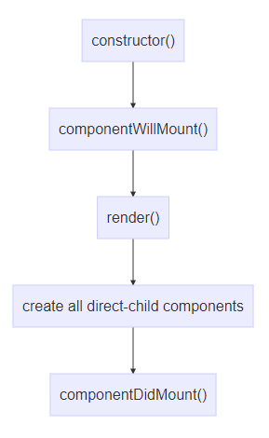
Component creation
The first cycle is the creation for component, which usually happens the first time a component is encountered in the parsed JSX tree

Slide 30
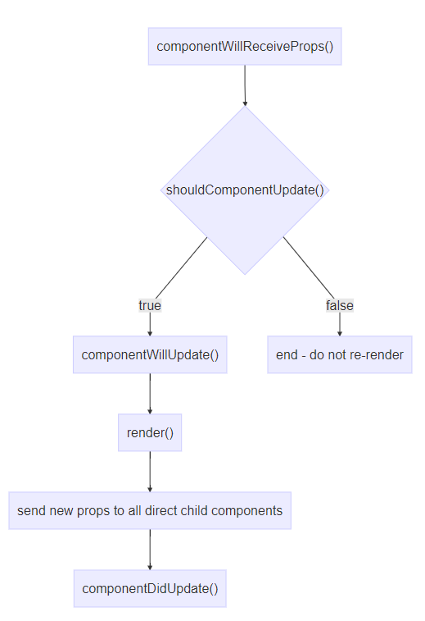
Component re-rendering due to re-rendering of the parent component

Slide 31
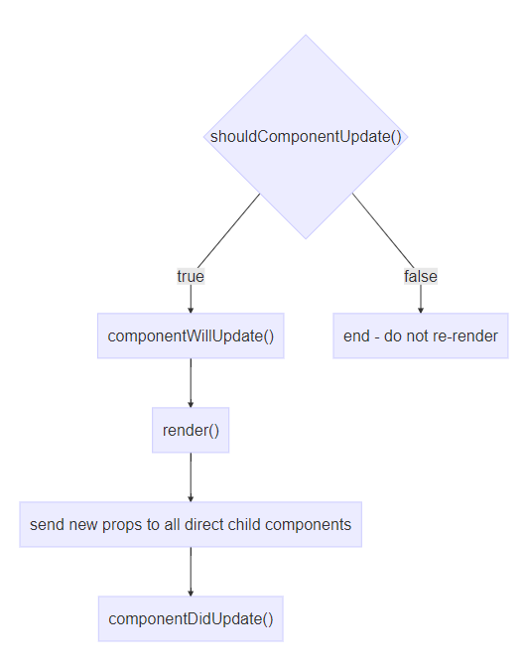
Component re-rendering due to internal change (e.g. a call to this.setState())

Slide 32
Class components -- stateful components -- container | Functional components– stateless component – presentation purpose
Using the class keyword Export | function(props)
This.props | Props-- immutable
State –yes Mutating data | No other functions Constructor –invalid State-no Other lifecycle --no
Render– return jsx logic | Return jsx

Slide 33
const getFakeMembers = count => new Promise((resolves, rejects) => {
const api = `https://api.randomuser.me/?nat=US&results=${count}`
const request = new XMLHttpRequest()
request.open('GET', api)
request.onload = () => (request.status == 200) ?
resolves(JSON.parse(request.response).results) :
reject(Error(request.statusText))
request.onerror = err => rejects(err)
request.send()
})

Slide 34
const Member = ({ email, picture, name, location }) =>
<div className="member">
<img src={picture.thumbnail} alt="" />
<h1>{name.first} {name.last}</h1>
<p><a href={"mailto:" + email}>{email}</a></p>
<p>{location.city}, {location.state}</p>
</div>
class MemberList extends Component {
constructor() {
super()
this.state = {
members: [],
loading: false,
error: null
}
}
componentWillMount() {
this.setState({loading: true})
getFakeMembers(this.props.count).then(
members => {
this.setState({members, loading: false})
},
error => {
this.setState({error, loading: false})
} ) }
render() {
const { members, loading, error } = this.state
return (
<div className="member-list">
{(loading) ?
<span>Loading Members</span> :(members.length) ?
members.map((user, i) =>
<Member key={i} {...user} /> ) :
<span>0 members loaded...</span>
}
{(error) ? <p>Error Loading Members: error</p> : ""}
</div> ) } }

